Slide 1
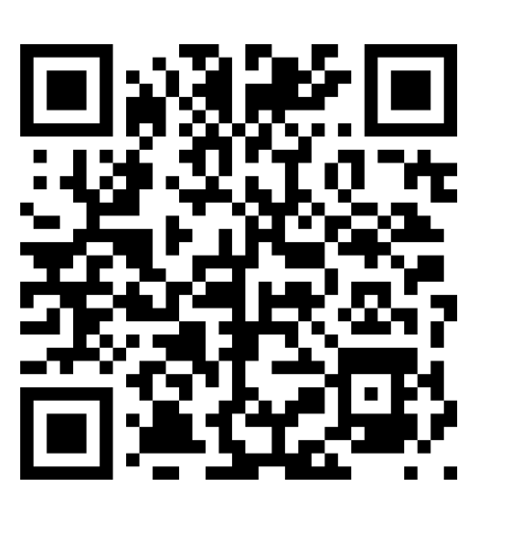
FAMILY climate survey
WHILE YOU WAIT…
Please visit:
https://survey.gadoe.org/FM?sid=CFF3E7D0
OR Scan the QR Code

Slide 2
Walton High School Educate. Inspire. Empower.
Class of 2029
High School Transition

Slide 3
Academic Program
7 period day – six classes and lunch
Each class earns .5 unit of credit
3 units per semester
6 units per year
total of 24 over the 4 years
Two semester system- grades are posted to the transcript at the end of each semester
Opportunities to earn more units of credit exist through Morning Tuition, online learning and summer programs

Slide 4
Promotion
Promotion Rules
10th grade: 5 units, including one full credit in English, math and science
11th grade: 10 units, including two full credits in English, math and science
12th grade: 16 units

Slide 5
Eligibility- GHSA
First-year students are eligible first semester. Must earn 2.5 units the first semester in order to be eligible for the spring semester.
Second-year students must have accumulated 5 total Carnegie units in the first year and have earned 2.5 units the previous semester.

Slide 6
Subjects | Diploma
English | 4 units of English Language Arts required for all students including 1 unit of Literature/Composition 1 and 1 unit of Literature/Composition 2
Mathematics | 4 units of Mathematics required for all students
Science | 4 units of Science required for all students, to include 1 unit of Biology, 1 unit of Physical Science or Physics, 1 unit of Chemistry, Earth Science, Environmental Science, or an AP Science, and 1 additional unit of science
Social Studies | 3 units of Social Studies required for all students, to include 1 unit of World History, 1 unit of United States History, 1/2 unit of American Government, and 1/2 unit of Economics
Health & Physical Education | 1 unit of Health and Personal Fitness are required for all students
Career Technical Education and/or Modern Language/Latin and/or Fine Arts | A total of 3 units are required from Career Technical Education, Modern Language, Latin and/or Fine Arts. Students planning to enter or transfer into a University System of Georgia institution or other post-secondary institution must take 2 units of the same modern language or Latin.
Electives | 4 additional elective units for all students
Total Units Minimum | 23 units

Slide 7
English Options
Literature/Composition I
1 summer reading novel
3 parallel readings per semester
Vocabulary book
Fundamentals of argumentative, expository and narrative writing
Homework: 30-45 minutes per week
Most reading assignments completed in class
Literature/Composition I Honors
1 summer reading novel
3 parallel readings per semester
Accelerated vocabulary book
Develop voice and sophistication in writing through narrative, analytical, and argumentative essays
Homework: 2-2.5 hours per week
Independent reading is expected
Notes:
Students are recommended for honors if they have an A average or based on teacher recommendation and highly motivated. Must enjoy reading!! 47% of current 9th graders are taking honors

Slide 8
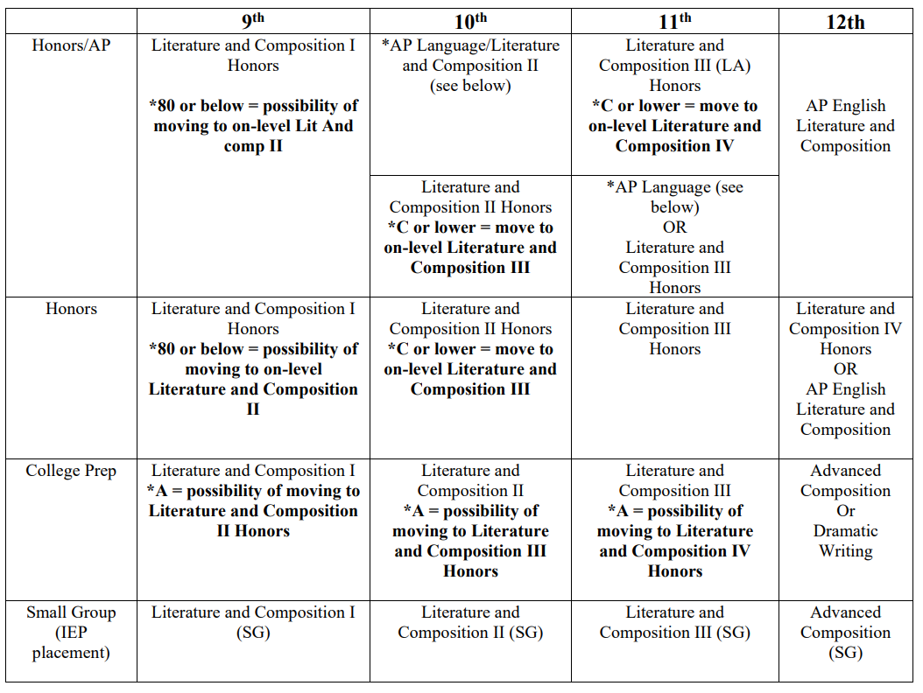

Slide 9
Mathematics
Enhanced Courses
-go at a faster pace
-include 2 years of curriculum-
-very little calculator usage
-Accelerated courses earn ½ EQP for BOTH courses
-Embedded credit (grade counts twice!)
Honors Courses
-more rigorous
-higher-order thinking questions,
-can take two math courses during sophomore year to reach Calculus
-less calculator usage
- Honors courses earn ½ EQP
**All Algebra courses take the same Ga Milestones EOC

Slide 10
GSE Algebra with support
No state curriculum for support
2 classes per day allows for more practice and processing time
Math support is an academic elective
Students can waive out of Support with parent permission

Slide 11
Foundations of Algebra A&B (fall) & Algebra 93 A&B (SPring)
Set state curriculum to review, revisit and expand understanding of foundational algebra concepts
2 Math classes per day allowing more practice & processing time
CORE Math credit
Students who take Foundations of Alg must take the course the entire year and cannot waive midway through the year

Slide 12
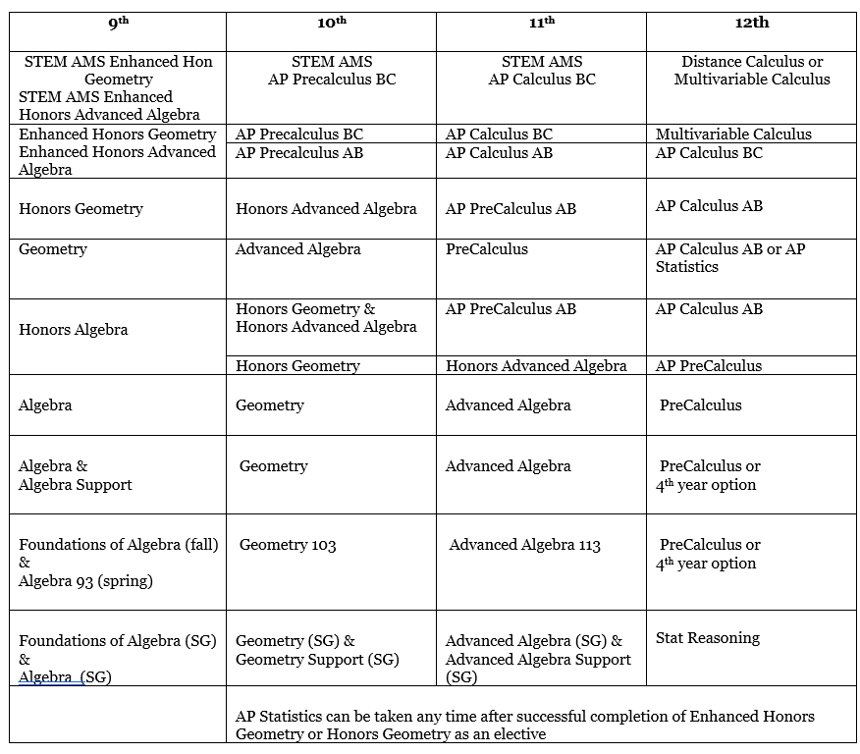
Notes:
All based on test average not overall grade.

Slide 13
Science
All rising 9th graders will take Biology. Biology is the study of living things from the molecular level to the larger ecological levels
Biology
Estimated 1 hour per week for HW and review outside of class
Honors Biology
Students must have been recommended for Honors 9th Lit (but may choose to waive out).
3 hours homework per week
Tests will consist of more analytical and more critical thinking problems
Course is a pre-requisite for many AP science courses such as AP Biology

Slide 14
 | 9th | 10th | 11th | 12th
Honors | Honors Biology (students recommended for Hon English) | Honors Chemistry (taken concurrently with geometry or higher math) Available Electives Honors Anatomy/Physiology | Honors Physics AP Physics 1 AP Physics C Available Electives AP Biology AP Chemistry AP Environmental Science Honors Anatomy/Phys Honors Biotechnology Forensics Environmental Science | Course Options Honors Physics AP Physics 1 AP Physics 2 AP Physics C AP Physics Emag AP Biology AP Chemistry AP Environmental Science Honors Anatomy Physiology Honors Biotechnology Forensics Environmental Science
College Prep | Biology | Chemistry Available Electives Anatomy/Physiology Environmental Science | Physics Available Electives Anatomy/Physiology Forensics Environmental Science Astronomy | Course Options Anatomy/Physiology Environmental Science Astronomy Forensics
3-level | Biology 93 | Environmental Science 103 | Physics 113 | Course Options Anatomy/Physiology 123 Astronomy Chemistry

Slide 15
World Geography AP Human Geography
Summer Requirements
Summer Packet – will be posted on Walton
Website at the end of the semester
1.
Summer Packet – will be posted on Walton
Website at the end of the semester
2. Know the relative location of most of the countries in the world, plus several sub-national regions.
Curriculum
Thematic
Catch Up Unit: Physical Geo. & History
General Geographical Concepts
Demography & Migration
Cultural Geography (language & religion)
Political Geography
Agriculture and Rural Land Use
Industrialization
Urbanization
Thematic
Semester 1: Physical Geography, Cultural Geography, and Demography & Migration
Semester 2: Political, Environmental and Economic Geography

Slide 16
World Geography AP Human Geography
Homework per day
15-25 minutes
30-45 minutes
Writing component
3- or4-part free response questions (FRQs) throughout the semester (20% of unit assessments)
One formal DBQ essay
7-part free response questions (FRQs) which account for 50% of unit assessment
Reading component
Various articles/book chapters/PSAT-style readings given
Textbook is written at the 11-12th grade level (used sparingly)
Reading Quizzes used to assess reading per chapter
Most parallel readings are written at the college level and are assessed through reading quizzes and Socratic seminars
Grading Scale
Tests 40%
Reading Assessments 15%
Daily/HW 20%
Projects/DBQ 20%
Final Exam 10%
Homework 15%
Reading Assessments 20%
Tests 40%
Student Enrichment Grades 10%
Final Exam 15%
Notes:
57% of current 9th graders are taking APHG. 94% of last year’s 352 students earned a 3 or higher on the test.

Slide 17
 | 9th | 10th | 11th | 12th
ISA Spanish Students | AP Human Geography | AP U.S. Government *ISA class with Spanish component | AP U.S. History *ISA class with Spanish component | World History (any level) *Students should consider taking AP European History as an elective.
Advanced Placement | AP Human Geography | AP U.S. Government & AP Microeconomics *Possible AP electives include AP Macroeconomics, AP Comparative Gov and AP European History | AP U.S. History *Possible AP electives include AP Macroeconomics, AP Comparative Gov, AP European History, AP Art History, AP Psychology | AP World History *Possible AP electives include AP Macroeconomics, AP Comparative Gov, AP European History, AP Art History and AP Psychology
Honors Level | AP Human Geography | Honors U.S. Government & Honors Economics | Honors U.S. History | Honors World History
College Prep | World Geography | U.S. Government & Economics | U.S. History | World History
3 – Level | Foundations of Social Studies 93 | U.S. Government 103 & Economics 103 | U.S. History 113 | World History 123
Graduation Requirements: 1 unit of World History 1 unit of U.S. History ½ unit of Government ½ unit of Economics |  | AP Microeconomics – meets the Economics graduation requirement AP Macroeconomics – counts as an academic elective AP U.S. Government – meets the Government graduation requirement AP Comparative Government – counts as an academic elective Level recommendations will be made each year by social studies teachers to ensure proper level placement and rigor of coursework. All 3-level classes can only be taken with teacher recommendation.

Slide 18
World Languages
Freshman | Sophomore | Junior | Senior
Chinese I | Chinese II | H Chinese III | H Chinese IV
Chinese II | H Chinese III | H Chinese IV | H Chinese V
Latin I | Latin II | H Latin III | AP Latin
Latin II | H Latin III | AP Latin | H Latin V
French I | French II | H French III | H French IVH
French II | H French III | H French IV | AP French Lang
reshman | Sophomore | Junior | Senior
Chinese I | Chinese II | Chinese III | Chinese IV
Latin I | Latin II | Honors Latin 3 | AP Latin
Latin II | Honors Latin 3 | AP Latin | Honors Latin V
Freshman | Sophomore | Junior | Senior
French II | French III Honors | French IV Honors | AP French Language
French I | French IIA | French III Honors | French IV Honors

Slide 19
World Languages
 | Freshman (Fall) | Freshman (Spring) | Sophomore | Junior | Senior
Language Track | Spanish IIA | Spanish IIB | Spanish III Honors | Spanish IV Honors | AP Spanish Language or Spanish V Honors
Advanced Track | Spanish IIA | Spanish IIB Honors | Spanish III/IV Honors (Pre-AP Spanish) | AP Spanish Language | AP Spanish Literature
 |  |  |  | Spanish V Honors | AP Spanish Language
Language Track for entering freshmen | Spanish IA | Spanish IB | Fall Semester: Spanish IIA Spring Semester: Spanish IIB or Spanish IIB Honors | Spanish III Honors or Pre-AP (for students from Honors Spanish II) | Spanish IV Honors or AP Spanish Language (for students who completed Pre-AP)

Slide 20
Rigorous course work
Challenging course work directly relates to standardized test scores
Challenge yourself in areas of strength
COGAT/IOWA scores
College admissions- progression in your rigor over the four years
Prepared for post-secondary work

Slide 21
GPA and Extra Quality Points
ALL honors course will earn an .5 Extra Quality Point and AP will earn a 1.0 Extra Quality Point.
A in a college prep course is 4.0
B in a college prep course is 3.0
A in an honors course is 4.5
B in an honors course is 3.5
A in an AP course is 5.0
B in an AP course is 4.0

Slide 22
How to have a balanced schedule as a freshman…
Student #1
4.0 – weighted / 4.0 - unweighted
9th Lit- 92
Foundation of Alg A- 94
Foundations of Alg B-94
Biology 93- 91
Study skills – 99
Spanish I -90

Slide 23
How to have a balanced schedule as a freshman…
Student #2
3.583 – weighted / 3.166 - unweighted
Honors 9th Lit- 82
H Geometry- 82
Honors Biology - 87
AP Human- 86
Spanish II – 89
Orchestra-98

Slide 24
How to have a balanced schedule as a freshman…
Student #3
3.833 – weighted / 3.667 - unweighted
9th Lit - 94
H Algebra- 85
H Biology- 84
World Geog- 90
Spanish II – 95
Health - 100

Slide 25
How to have a balanced schedule as a freshman…
Student #4
4.25 – weighted / 4.0 - unweighted
9th Lit - 94
H Algebra- 95
Biology- 94
AP Human Geog- 90
Spanish II – 95
Health - 100

Slide 26
High school hints
-Students are not allowed to retake assessments to improve their grade. Be well prepared for every assessment!
-Regular homework is expected. Missing homework will result in a grade of zero. Stay on top of all assignments!
-Teachers are available before and after school as well as WEBs for extra help and make up work.
-Use WEB time wisely!
-Take a course load that is right for your student. We want BALANCE!

Slide 27
High School Course Registration
-List of courses generated from MS teacher recommendations made on criteria set by Walton.
-Every list of courses should include English, Math and Science. Any other classes listed are considered electives for 9th graders
-Walton is a traditional bell schedule with a 7-period day. This means a full-time student should have 6 courses and a lunch.
-Elective registration opens Friday, March 7th at 7am and will close at 9:00pm on Sunday, March 23rd.

Slide 28
Why is registration important?
-We build our master schedule and hire staff according to student course requests.
-There is not an option to "sample" a course and then change your decision.
-Our goal is to ensure that every student is appropriately challenged and advancing toward meeting high school graduation standards.

Slide 29
Elective course registration
-ALL students must complete elective course registration!!
-Elective course registration can be accessed through the student's CTLS (Dickerson – Homeroom CTLS tile & Dodgen – 3rd period class CTLS tile).
-Prepare ahead of time and read carefully – can only submit elective registration ONE TIME!
-What you will find in the CTLS homeroom:
1. Link to elective course registration
2. Link to electronic waiver form
3. Information about registering & paying for zero period
4. Link to online course form

Slide 30
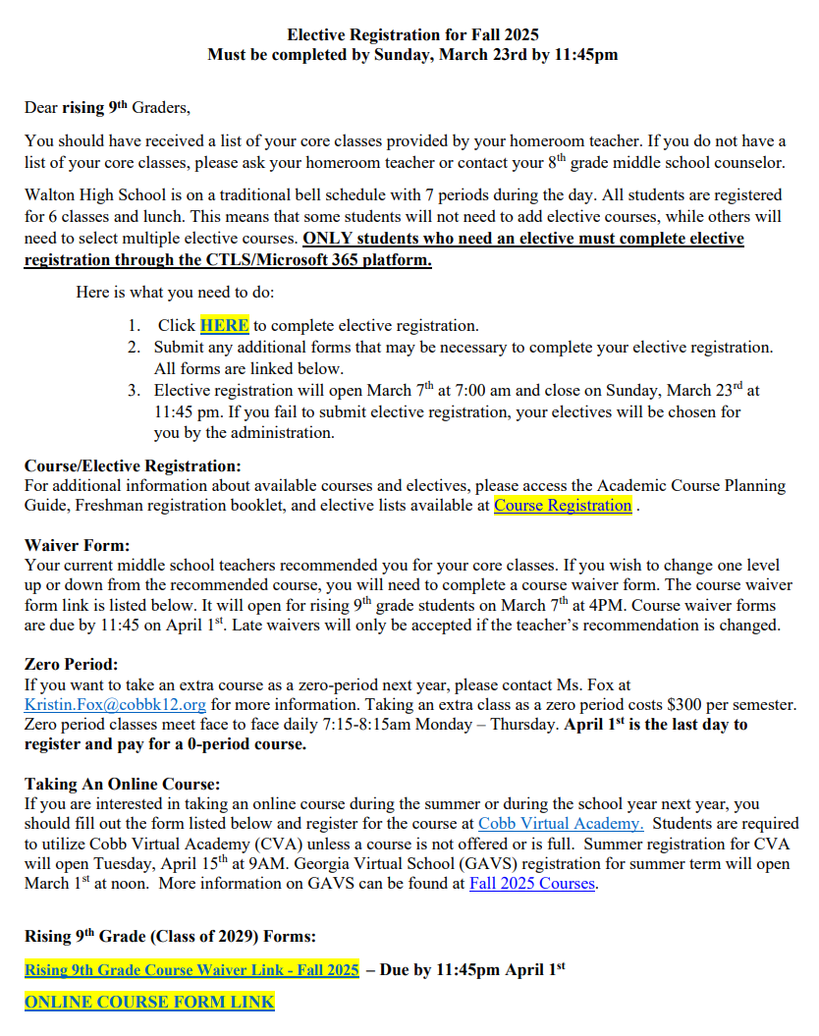

Slide 31
Zero period
-This is NOT required and is NOT for everyone.
-Zero period classes meet Monday-Thursday 7:10 – 8:10am
-Parent/guardian is responsible for transportation.
-Who takes zero period?
-Course 8 (extra course)
- Example: Student wants to take English, math, science, social studies, orchestra, Spanish and Latin or a STEM student is taking English, math, science, social studies, orchestra, Spanish, and a STEM elective.
-If interested in zero period, you must express interest and pay for the course NOW. If no zero-period class works in your schedule, you will receive a refund.
-Cost is $300. Email Kristin Fox at Kristin.Fox@cobbk12.org for more information. Deadline to register and pay for zero period is April 1st.

Slide 32
Waivers
What is a waiver?
A form you submit to request a course one academic level different from the teacher recommendation.
How do I submit a waiver?
Electronic form will be distributed, and waivers are due April 1st.
What does this mean for my child?
Your child will be required to stay in the course for the semester even if the teacher decides he/she is misplaced.

Slide 33
Other FAQs
What if my child is in STEM or ISA?
-Once your child commits to the STEM or ISA program, the school will automatically update course lists.
What if I want to drop a class on my student’s course list?
-You will do this through the elective registration form found in the CTLS homeroom.
What if my child is taking a course over the summer?
-You can find information about the process in the CTLS homeroom. There is an online form linked in CTLS. You are responsible for registering your child through CVA or GAVS.
Who should I direct my questions to?
For now, your 8th-grade middle school counselors:
Dickerson – Ms. Jackson (Latasha.Jackson@cobbk12.org)
Dodgen – Ms. Hammonds (Kaley.Hammonds@cobbk12.org)

Slide 34
Walton 101
PTSA Sponsored – Learn the Nuts N Bolts
Tuesday, April 22nd
6:00 p.m.
Lecture Hall (inside the library)

