Slide 1
Financial Aid 101:
Federal and State Aid
Anna Roberts
aroberts@gsfc.org
Notes:
Because financial aid can be confusing for many, today, we will be spending time highlighting the process for a student to acquire funding for their post-secondary education.

Slide 2
Agenda
Define Financial Aid
Types of aid
Federal Programs
Georgia’s Financial Aid Programs
Application Process - FAFSA
Financial Aid Package
Notes:
To start, I will define financial aid, explain each type of funding, and the different sources that provide the funding.
By the end of this presentation, you will understand how to apply for aid, and compare a student’s financial aid package.

Slide 3
Financial Aid
Notes:
Let’s begin by discussing financial aid.

Slide 4
Financial Aid
Helps pay for educational expenses
Direct and Indirect Costs
Costs of Attendance (COA)
Notes:
Financial aid helps pay expenses associated with attending a post-secondary institution, which may be referred to as a college, university, technical college, or even a community college. During this webinar, we will refer to each as an institution.
These expenses can be direct or indirect expenses. All of which are associated with the student’s Cost of Attendance (COA).

Slide 5
Direct and Indirect Costs
Direct Costs
Tuition and fees
On-campus housing
Meal plan
Parking permits
Indirect Costs
Books
Rent for off-campus housing
School supplies
Groceries
Notes:
Direct costs are paid directly to the institution. Some of these costs include: tuition and fees, on-campus housing, meal plan, and possibly even parking permits.
Indirect costs are expenses paid while a student is enrolled but the costs are not billed from the institution. Some examples are listed here.
(Presenter: be sure to read some of their responses: bedding, cell phone bill, gas, entertainment, etc.)

Slide 6
Cost of Attendance (COA)
Tuition and fees payable to the institution
Books and supplies
Room + board and meal plans
Personal costs
Transportation to and from the institution
Notes:
COA is an estimate of what it could cost at an institution per year. This doesn’t necessarily mean this is the exact amount a student will have to pay. It is simply a ball park figure.

Slide 7
Types of Financial Aid
Notes:
If a college graduate is asked how they paid for their education, most would say by using financial aid, which is a general term. The real question is, which type?

Slide 8
Financial Aid Types and Sources
Forms of Financial Aid:
Scholarships
Grants
Loans
Work-study programs
Sources of Financial Aid:
Federal and state government
Colleges and universities
Private foundations
Professional and service organizations
Employers and private companies
Notes:
Finding ways to pay for college is one of the most important, but also one of the most challenging tasks connected to attending college. Financial aid is any money used to help pay for college. Financial aid can cover tuition and fees, room and board, books and supplies, transportation and other college-related expenses.

Slide 9
Types of Financial Aid
Merit-based (HOPE Scholarship)
Need-based (Pell Grant)
Non-need based (HOPE Grant)
Student or parent loans
Employment opportunities (Federal Work Study)
Military aid and grants (Georgia National Guard Service Cancelable Loan; UNG ROTC Grant)
Savings plan (Path2College 529; traditional savings)
Notes:
Here are the different types of aid.

Slide 10
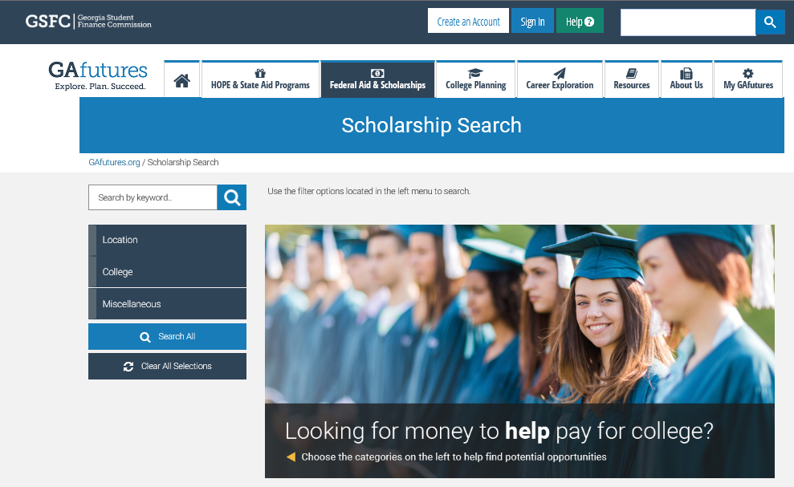
GAfutures Scholarship Search
Scholarship Search Tips
Start search early
Don’t stop at one, two, or three
Be creative
Consider family, hobbies, career interests, medical history, or college major
Look for scholarships even after beginning college
DO NOT PAY ANYONE TO HELP FIND OR APPLY FOR SCHOLARSHIPS!
Notes:
There are thousands of scholarships out there to help all types of students pay for college. Look for local and national scholarships with GAfutures.org’s search tool to find additional sources of financial aid. Some scholarships have some pretty unique eligibility requirements! Are you a vegetarian? An aspiring writer? An avid volunteer in your community? Then there may be a scholarship for you. Here are some tips to help.

Slide 11
Federal Aid Programs
Notes:
It is important to know how the aid is funded.

Slide 12
How to Get Federal Student Aid
Be a U.S. citizen or eligible non-citizen
Be a high school graduate or GED recipient
Be enrolled in an eligible degree/certificate program
Have a valid Social Security number
Maintain Satisfactory Academic Progress
Notes:
There are certain eligibility requirements in order to receive federal aid. These requirements are for the student not the parents.

Slide 13
Federal Financial Aid Programs Grants
Pell Grant
Undergraduate student with financial need
Maximum amount for 2024-2025 is $7,395
Federal Supplemental Educational Opportunity Grant (FSEOG)
Undergraduate student with exceptional financial need
Pell Grant recipients receive priority
Up to $4,000
Notes:
The federal government has financial aid programs that include grants and work-study awards that do not need to be repaid, as well as various loans that require repayment. For more information, visit studentaid.gov

Slide 14
Federal Financial Aid Programs Grants
TEACH Grant
Undergraduate, post-baccalaureate, or graduate student
Enrolled in coursework to begin a career in teaching
Must agree to serve as a full-time teacher in a high-need field in a public or private elementary or secondary school that serves low-income students
Up to $4,000; becomes a loan if you do not teach as required

Slide 15
Federal Financial Aid Programs Grants
Federal Work Study Program
Full-time or part-time undergraduate or graduate student
Earn at least minimum wage
On-campus positions
Campus tour guide
Library
Sporting events
Office assistant

Slide 16
Federal Financial Aid Programs Federal Direct Loans
Direct Subsidized Loan
Direct Unsubsidized Loan
Federal PLUS Loan – for parents of dependent undergraduate students
Grad PLUS Loan – for graduate and professional students
Notes:
The FAFSA also determines the amount of loans, subsidized and unsubsidized, you are eligible for.
These loans, of course, will have to be repaid once you are no longer in school. Repayment begins six months after graduation or if the student is no longer enrolled at least half time.
Federal PLUS Loans are unsubsidized loans made to parents of undergraduate students. If your parents cannot obtain a PLUS loan, you may be eligible to borrow additional Unsubsidized Stafford loan funds. The interest rates may vary based on when the loan is borrowed.
With the Grad PLUS Loan, graduate and professional students are also eligible to borrow under the PLUS Loan program to help pay for their education.

Slide 17
Federal Financial Aid Programs Direct Subsidized Loans
Direct Subsidized Loan
Available to undergraduate students with financial need
Interest is paid by the government while enrolled (at least half time)
Amount determined by institution and based on COA, financial need, other aid and loan limits
Current interest rate 6.53% (undergraduate)

Slide 18
Federal Financial Aid Programs Direct Unsubsidized Loans
Direct Unsubsidized Loan
Available to undergraduate/graduate students
Institution determines the amount based on COA, other financial aid awarded, and loan limits
Student responsible for paying the interest
Can choose to defer interest while enrolled at least half time, but interest will be added to the principal amount of loan
Current interest rate 6.53% (undergraduate)
Current interest rate 8.08% (graduate/professional)

Slide 19
Federal Financial Aid Programs Direct Plus Loans
Parent PLUS loan for a parent of dependent
Only one parent will be the borrower
Can have more than one loan for additional dependent student
Grad PLUS loan for graduate or professional student
Approval based on credit history
Maximum amount is COA minus any other financial aid awarded
Current interest rate is 9.08%

Slide 20
Federal Loan Program Limits
2023-2024 Academic Year
Initial Loan Amount for Dependent Students whose Parents are Eligible for a PLUS Loan | Base | Additional Unsubsidized | Annual Maximum Amount
Freshmen | $3,500 | $2,000 | $5,500
Sophomore | $4,500 | $2,000 | $6,500
Junior/Senior | $5,500 | $2,000 | $7,500
Independent Students and Dependent Students whose Parents were Denied a PLUS Loan | Base | Additional Unsubsidized | Annual Maximum Amount
Freshmen | $3,500 | $6,000 | $9,500
Sophomore | $4,500 | $6,000 | $10,500
Junior/Senior | $5,500 | $7,000 | $12,500
Notes:
Depending on what type of loan you and/or your parents qualify for, there are some limits to the amount of funds you can receive.
First-year undergraduates are eligible for loans up to $5,500.
Amounts increase for subsequent years of study, with higher amounts for graduate students. The interest rates may vary based on when the loan is borrowed.

Slide 21
Georgia’s Financial Aid Programs
Notes:
Now let’s discuss financial aid opportunities offered by the state of Georgia.

Slide 22
Helping Outstanding Pupils Educationally Program
HOPE Scholarship
Zell Miller Scholarship
HOPE
Grant
HOPE Career Grant
Zell Miller Grant
Notes:
Think of the HOPE Program as a family and the Georgia Lottery as the parent. The HOPE Program provides money to assist students with their educational costs.
click

Slide 23
HOPE Program
General Eligibility Requirements
Be a legal resident of Georgia
Be registered with the Selective Service, if required
Be in compliance with the Georgia Drug-Free Postsecondary Education Act of 1990
Meet U.S. citizenship or eligible non-citizen requirements
Be in good standing on all student loans and other financial aid programs
Attend an eligible postsecondary institution
Must be working toward the first undergraduate program
Notes:
These are the general eligibility requirements for the HOPE Program.
Click

Slide 24
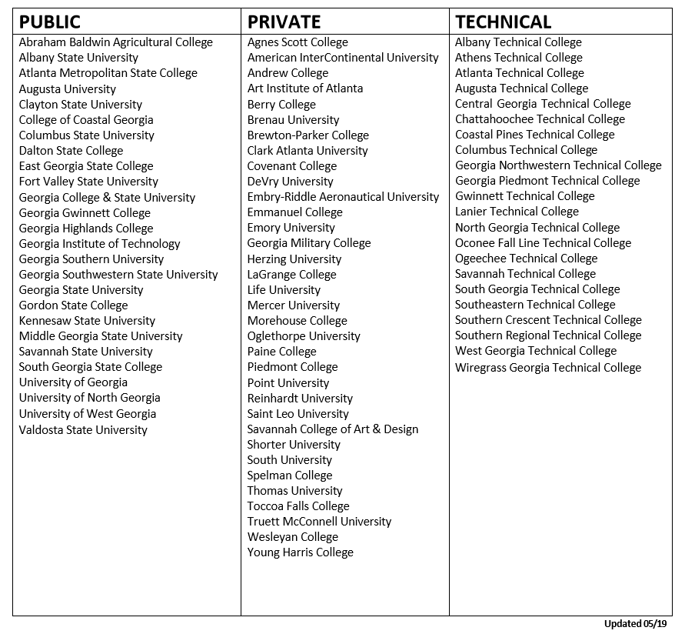
Eligible Institutions
Notes:
To be awarded HOPE, a student must attend one of the eligible institutions within the state of Georgia.
This includes public, private, and technical colleges and universities. Students can only be awarded HOPE at one institution at a time.
For this complete list of eligible institutions, always feel free to visit our website GAfutures to select the tab for HOPE and State Aid Programs.
Click

Slide 25
HOPE Scholarship
HOPE Program
HOPE
Scholarship
Zell Miller
Scholarship
HOPE
Grant
Zell Miller
Grant
HOPE Career Grant
Notes:
Next, lets talk about the eligibility requirements for the HOPE Scholarship.
Click

Slide 26
HOPE Scholarship Eligibility Requirements
Students must pursue an associate or bachelor’s degree
Graduate with a 3.0 high school HOPE GPA
After high school graduation, may also be earned in college
4 academically rigorous course credits
Notes:
First, the HOPE Scholarship is awarded to students pursuing an associates or bachelors degree.
Students must graduate with a 3.0 high school HOPE GPA from a Georgia high school, and 4 academically rigorous course credits.
For home school students, the requirements differ. For more information, contact us.
Click

Slide 27
Academically Rigorous Courses
Courses must be on Academic Rigor Course List. This includes:
Advanced Placement (AP)
International Baccalaureate (IB)
Dual Enrollment in degree level core subjects
Advanced math
Advanced science
Foreign language II or higher
Notes:
Rigor credits can be earned by taking AP, IB, or Dual Enrollment core courses.
Rigor credits can also be earned from advanced courses. For example, Anatomy and Physiology, Chemistry, Biology 2, Pre-Calculus, Algebra 2, and a second or third year of a foreign language, are all considered rigor courses.
If unsure about a course and whether it is considered academically rigorous, visit GAfutures.org to select the tab for HOPE and State Aid Program.
Click

Slide 28
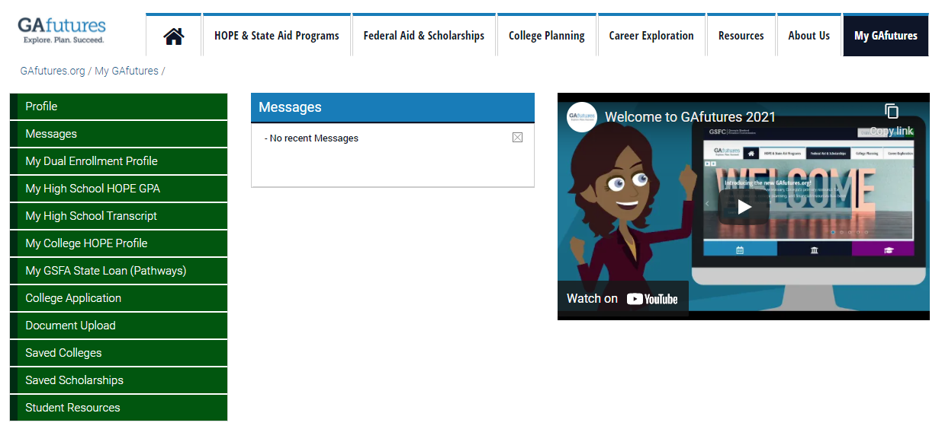
My High School HOPE GPA
ONLY calculated by GSFC
Only core courses from 9th through 12th grade
Transcripts are uploaded by the high school
4 academically rigorous course credits
Log into GAfutures.org account to access HOPE GPA
Notes:
The high school HOPE GPA, found on GAfutures, may differ from the GPA from your high school. The high school HOPE GPA is ONLY calculated by GSFC and is based on core courses while the student is in high school.
High school HOPE GPAs are calculated every academic year, when transcripts are uploaded by high schools.
Students must also graduate with 4 rigor course credits.
Click

Slide 29
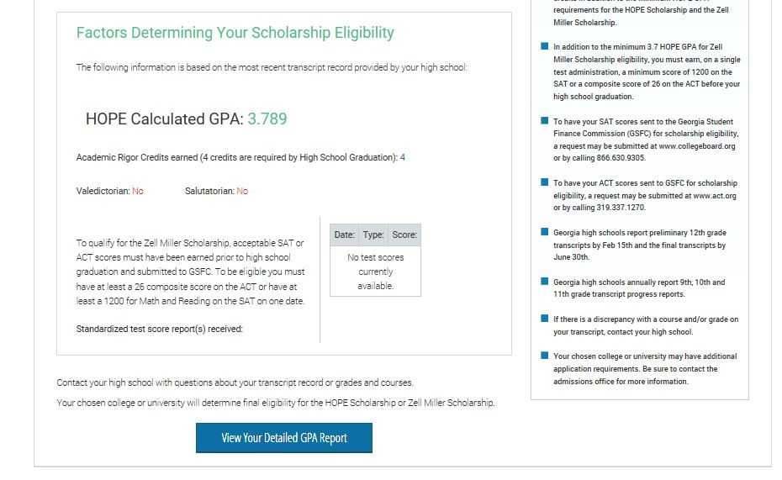
My High School HOPE GPA

Slide 30
Maintaining the HOPE Scholarship
Students must maintain 3.0 college HOPE GPA at all checkpoints including:
End of every Spring semester/quarter
30/45 attempted semester/quarter hours
60/90 attempted semester/quarter hours
90/135 attempted semester/quarter hours
Three-Term Checkpoint, if enrolled less than full-time for first three semesters/quarters
Notes:
To maintain the HOPE Scholarship while in college, a student must maintain at least a 3.0 college HOPE GPA at all checkpoints including every spring term of enrollment.
Click

Slide 31
College HOPE GPA
College students receiving HOPE/Zell Miller funds
Notes:
Students are able to track their college HOPE GPA on GAfutures by logging in, clicking on “My GAfutures” and then on their “College Profile”.
Click

Slide 32
College HOPE GPA
ONLY calculated by GSFC
Calculated every semester/quarter
STEM courses are weighted .5 for all grades except an A and F
High school Dual Enrollment courses are not included
Notes:
The college HOPE GPA may differ from the GPA from the institution. The college HOPE GPA is ONLY calculated by GSFC.
The college HOPE GPA is calculated every term, STEM courses are weighted .5, and high school Dual Enrollment courses are not included.
Click

Slide 33
Zell Miller Scholarship
HOPE Program
HOPE
Scholarship
Zell Miller
Scholarship
HOPE
Grant
Zell Miller
Grant
HOPE Career Grant
Notes:
Next, let’s talk the Zell Miller Scholarship.
Click

Slide 34
Eligibility Requirements
Rigor Requirements and one of the following:
Designated valedictorian or salutatorian AND Meet minimum HOPE eligibility requirements |  |  | Minimum 3.7 high school HOPE GPA, as calculated by GSFC, in core curriculum courses AND 1200 SAT total test score OR 25 ACT composite score
Notes:
To receive the Zell Miller Scholarship, a student must meet the general eligibility requirements of the HOPE Program, as well as the following:
If the student is designated as the valedictorian or salutatorian, they are eligible to receive the Zell Miller Scholarship.
All other students, must graduate with:
a 3.7 high school HOPE GPA,
4 rigor course credits and
a 1200 on the SAT OR a 26 on the ACT
Students can take the tests multiple times and use the highest score. The test scores must be earned in one sitting and taken prior to graduation.
Click

Slide 35
Maintaining the Zell Miller Scholarship
Students must maintain 3.3 college HOPE GPA at following checkpoints:
End of every Spring semester/quarter
30/45 attempted semester/quarter hours
60/90 attempted semester/quarter hours
90/135 attempted semester/quarter hours
Three-Term Checkpoint, if enrolled less than full-time for first three semesters/quarters
Notes:
Maintaining the Zell Miller Scholarship is similar to the HOPE. The checkpoints are the same, but a student must have at least a 3.3 college HOPE GPA.
Click

Slide 36
HOPE & Zell Miller Scholarships
Students lose eligibility due to one of the following:
GPA requirement not met (3.0 for HOPE; 3.3 for Zell Miller)
Reaching maximum attempted hours
127 semester
190 quarter
Failing to use funds within ten years of high school graduation or equivalent
Exception for active duty military service in United States Armed Forces
Received bachelor’s or first professional degree
Notes:
There are a few ways students can lose their eligibility for the HOPE Scholarship and Zell Miller Scholarship:
Not maintaining your GPA
Reaching the maximum hours allowed
Failing to use your award within seven years
and receiving a bachelor’s or professional degree.

Slide 37
Grants
HOPE Program
HOPE
Scholarship
Zell Miller
Scholarship
HOPE
Grant
Zell Miller
Grant
HOPE Career Grant
Notes:
Now let’s talk about the grants.
Click

Slide 38
HOPE Grant
Eligibility Requirements:
Enrolled in certificate or diploma program
High school diploma/GED not required
High school GPA and/or test scores not considered
Notes:
Like all components of the HOPE Program, the general eligibility requirements will also apply to the grants.
Yet, what’s different is that grants can only be used for students who are enrolled in a certificate or diploma program.
Also, there is no high school HOPE GPA requirement, and test scores are not considered.
Click

Slide 39
Maintaining the HOPE Grant
Students must maintain a 2.0 college cumulative GPA at the following checkpoints:
30 HOPE Grant paid semester hours
60 HOPE Grant paid semester credit hours
Maximum 63 paid semester hours
Notes:
To maintain the HOPE Grant, Terri must have a 2.0 college cumulative GPA at the checkpoints.
Click

Slide 40
Zell Miller Grant
Eligibility Requirements:
Minimum 3.5 college cumulative GPA
Checkpoints occur at the end of every term of enrollment
Must be a HOPE Grant recipient initially
May be paid retroactively for first term
Maximum 63 combined paid hours Zell Miller and HOPE Grants
Notes:
To keep the Zell Miller Grant, must maintain at least a 3.5 college cumulative GPA every term.
Not eligible for Zell Miller Grant until one semester is completed because would have to have at least a 3.5 college cumulative GPA.
Click

Slide 41
Award Amounts
 | HOPE Scholarship | Zell Miller Scholarship
Public Institutions | portion of tuition | full standard tuition
Private Institutions Full-time | $2,496 per semester (fall, spring, summer) $1,664 per quarter (fall, winter, spring, summer) | $2,985 per semester (fall, spring, summer) $2,034 per quarter (fall, winter, spring, summer)
 | HOPE Grant | Zell Miller Grant
Public Institutions | portion of tuition | full standard tuition
Notes:
At public institutions, the HOPE Scholarship and Grant cover a portion of the tuition. Tuition rates can vary at each institution.
The Zell Miller Scholarship and Grant provide full tuition at our public institutions.
Neither award can be used for books, housing, meal plans, or fees. Only tuition.
Students can receive the HOPE or Zell Miller Scholarship at private institutions; it is a set amount per term of enrollment.
Students do not have to be enrolled full-time for these grants and scholarships. However, the awards are capped at 15 credit hours. This also applies to courses taken in the summer.
Click

Slide 42
HOPE Career Grant
HOPE Grant and Zell Miller Grant recipients eligible for HOPE Career Grant
Movie Production and Set Design
Computer Programming
Computer Technology
Practical Nursing
Early Childhood Care and Education
Welding and Joining Technology
Precision Manufacturing
Certified Engineer Technician
Commercial Truck Driving
Health Sciences
Diesel Equipment Technology
Industrial Maintenance Technology
Automotive
Aviation
Construction
Electrical Line Worker
Logistics
Law Enforcement
Notes:
The HOPE Career Grant has become a great financial resource for many students.
Students receiving the HOPE Grant or the Zell Miller Grant may also be eligible for additional financial assistance from this program.
This program was created to boost enrollment in high-demand certificate and diploma programs such as Commercial Trucking, Early Childhood Care/Education and Practical Nursing.
There are 17 in-demand career fields with more than 300 approved certificate and diploma programs eligible for the HOPE Career Grant.
Five new fields were added in FY 2018: Construction, Aviation, Electrical Line Work, Logistics and Automotive Technology.
The award is a fixed amount depending on the program and number of hours the student is enrolled.
You can find a list of approved programs and award amounts at GAfutures.org

Slide 43
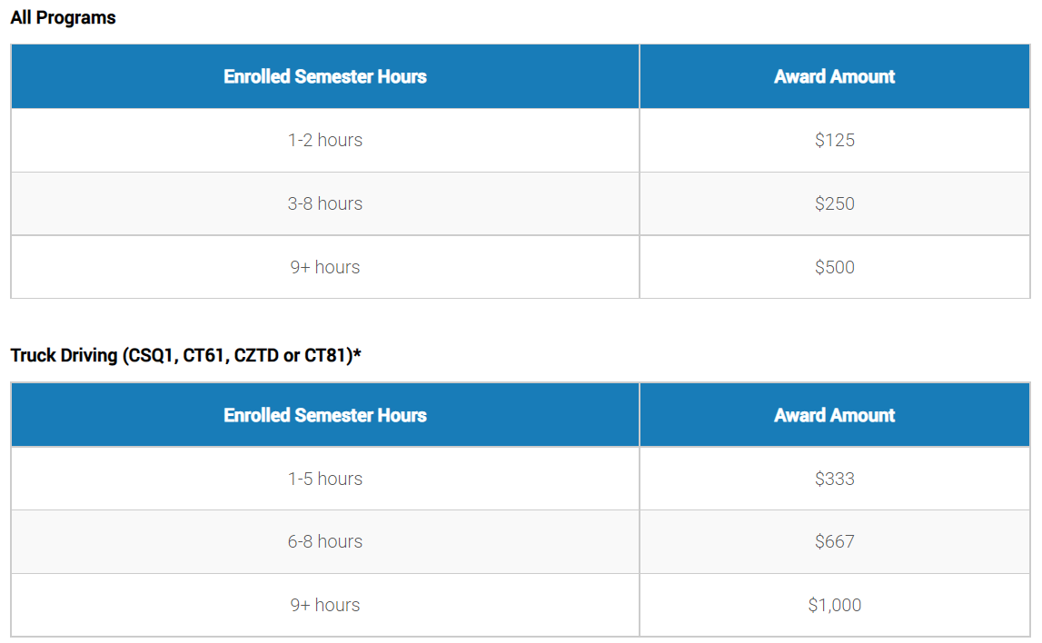
HOPE Career Grant
Notes:
The HOPE Career Grant is a set amount which is based on two factors: the number of credit hours within the term of enrollment AND the program of study.
Just a side note, a student could have full standard tuition paid with the combination of the HOPE Grant and the HOPE Career Grant.
Click

Slide 44
Other State Programs
Georgia National Guard Service Cancelable Loan
Provides tuition assistance to eligible members of the Georgia National Guard for undergraduate and graduate programs; member agrees to service repayment
Public Safety Memorial Grant
Provides assistance to the dependent children of Georgia public safety officers who were permanently disabled or killed in the line of duty
Tuition Equalization Grant (TEG)
Provides grant assistance toward educational costs to Georgia residents enrolled full-time at an eligible private college or university
Notes:
Here are some other programs administered by the Georgia Student Finance Commission.
Georgia National Guard Service Cancelable Loan assists with tuition for undergraduate and graduate school and may be forgiven if the Guard member completes commitment with the National Guard.
Georgia Public Safety Memorial Grant
Public safety officers include: law enforcement officers, firefighters, emergency medical technicians, paramedics, highway emergency response operators (HERO) and prison guards. Funds may be used toward the cost of attendance at eligible colleges or universities in Georgia.
Tuition Equalization Grant provides assistance to eligible students attending full-time at a HOPE-eligible private institution.

Slide 45
Other State Programs
Georgia Military College State Service Scholarship
HERO Scholarship
REACH Scholarship (scholars selected during middle school)
University of North Georgia Military Scholarship
University of North Georgia ROTC Grant
University of North Georgia ROTC Grant for Future Officers
Notes:
The Georgia Student Finance Commission administers a number of other state programs to help Georgians pay for college.
More information and eligibility requirements for all of these programs can be found at GAfutures.

Slide 46
Completing the FAFSA
Notes:
With each type of aid there is an application process. It would be amazing if there was one application for all the financial aid, but like most things…it can’t be that easy. Let’s work through each process.

Slide 47
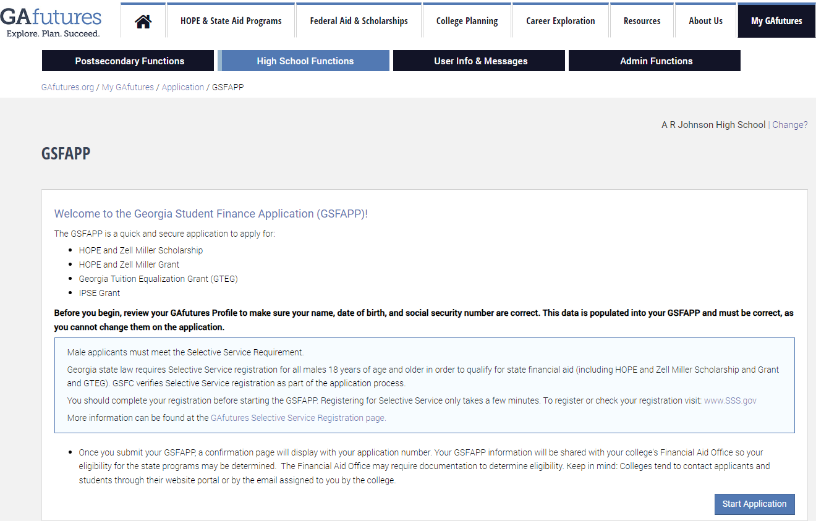
Application and Process
Notes:
A student must apply for the HOPE Program in one of two ways, through the FAFSA and/or the GSFAPPS, located on GAfutures.org.
Click

Slide 48
The Georgia Student Finance Application (GSFAPP)
Determine eligibility for state aid only
One time application
GAfutures account
GA State Aid
HOPE Eligible Institution
Notes:
Students can use the Georgia Student Finance Application or GSFAPPS to apply for the HOPE Program.
No, it’s not the latest app that you can download on your phone. It is a one-time application for state aid only.
To complete the GSFAPPS, students must have GAfutures account.
Click

Slide 49
Free Application for Federal Student Aid (FAFSA)
Studentaid.gov
Renew annually
Determines eligibility for federal and state aid
List up to 20 institutions
Will be available on December 1st 2024
Federal Aid
GA State Aid
HOPE Eligible Institution
Notes:
The Free Application for Federal Student Aid or FAFSA becomes available on October 1st each year. Students can submit the application, and it must be renewed annually.
The FAFSA will determine eligibility for Federal Student Aid. To make things easier, some of the information from the FAFSA is also used to determine eligibility for state aid.
Students can list up to 10 institutions on the FAFSA. To receive state aid, one institution must be HOPE eligible.
We have two great documents under the Resources tab on GAfutures.org to guide students through the FAFSA process; yet, that information can also be found here in the links for GAfutures webinar documents.
Click

Slide 50
Completing the FAFSA (Free Application for Federal Student Aid)
First step in financial aid search
Application is free
Begin by creating FSA ID
Use to sign your FAFSA
If dependent student, parent will also need an FSA ID
Find a FAFSA Completion event for help
Check with school counselor for financial aid nights or FAFSA workshops
Visit Gafutures.org for events nearby
Do not pay anyone to complete FAFSA
Notes:
The first step in your search for financial aid both federal and state, is to complete the Free Application for Federal Student Aid (FAFSA). Submitting a FAFSA is free and starts with creating your FSA ID. Your parent may also need an FSA ID as well if you are a dependent student.
If you need help, check with your school counselor about financial aid nights or FAFSA Completion events near you. Visit Gafutures.org for more information.

Slide 51
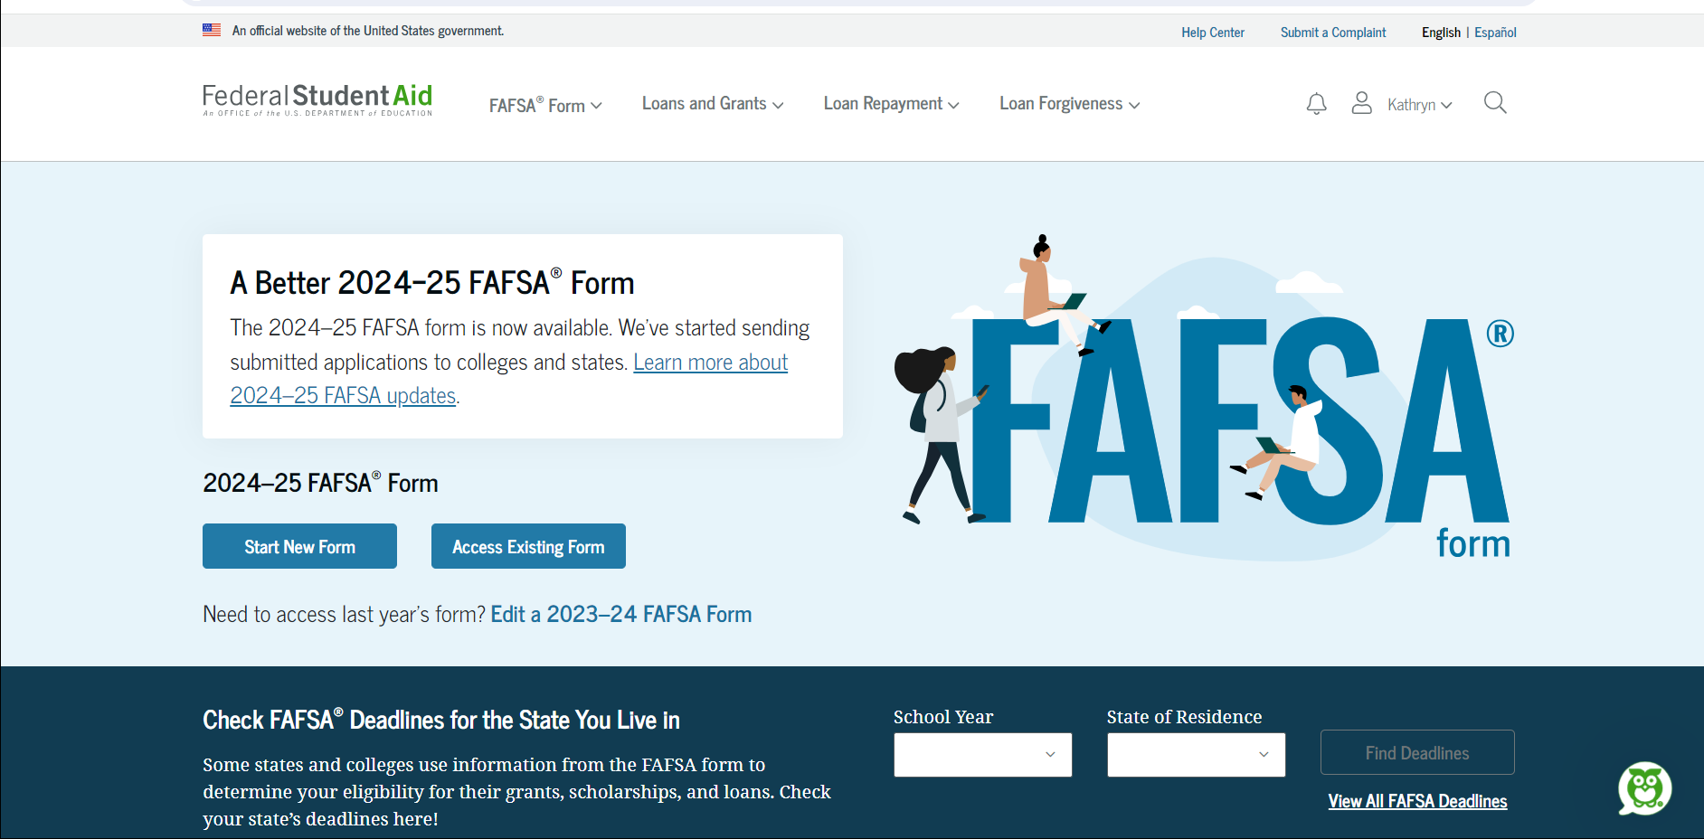
Completing the FAFSA
www.studentaid.gov website
Notes:
FAFSA.gov and the myStudentAid app are the only ways to submit the FAFSA. Students must use their FSA ID to log in.

Slide 52
When to Submit the FAFSA
FAFSA
2024-2025
FAFSA
2025 - 2026
If attending:
If attending:
Fall 2024
Fall 2025
Spring 2025
Spring 2026
Summer 2025
Summer 2026
Use 2022 tax returns
Use 2023 tax returns
Available
December 31st 2023
Available
December 1st 2024
Notes:
Click

Slide 53
What Is Needed to Complete the FAFSA
Social Security number (Alien Registration Number, if not a U.S. citizen)
Federal income tax returns, W-2s and other records of money earned
Bank statements and investment records (if applicable)
Records of untaxed income (if applicable)
An FSA ID to sign electronically
Notes:
To complete the FAFSA you will need
You and/or your parents tax returns for the required year
Information on any untaxed income, such as child support
And other basic household information

Slide 54
Steps to Creating an FSA ID
Go to studentaid.gov and click the link to create an FSA ID
Create a username and password, and enter email
Enter demographic information and select challenge questions and answers
Review information and read and accept the terms and conditions
Confirm cell number and email address by using the secure code
For additional help, visit StudentAid.gov/fsaid
Notes:
You can use your FSA ID to sign your FAFSA right away. Here are the steps to create an FSA ID.

Slide 55
FSA ID Tips
Create your own FSA ID
Never share FSA ID
Keep and remember FSA ID
Use FSA ID each year to fill out FAFSA and for lifetime of any loans
Parents may need to create FSA ID as well
Email address can be associated with only one FSA ID
Notes:
Some other tips for your FSA ID include:
Never tell anyone else your FSA ID—not even your parent, child, school official, or loan company representative. Remember, your FSA ID is your signature. Protect it!
You’ll use your FSA ID every year you fill out a FAFSA and for the lifetime of any loans. So be sure to take a little time while making it to create a memorable username, password, and answers to your “challenge questions.” Keep your FSA ID in a safe place, or memorize it.

Slide 56
Comparing Financial Aid Packages

Slide 57
Comparing Financial Aid Packages
To receive a Financial Aid Package, a student must:
List the institution on the FAFSA
Complete verification process, if selected
Apply for admission
And at some institutions, be accepted
Each institution is different. For more information, check with the Institution’s financial aid office.
Notes:
A financial aid package, sometimes called an award letter, tells students what financial aid they can receive at an institution.
A student can list up to ten institutions on the FAFSA. However, if they have not applied for admissions or have not been accepted, those institutions will probably not provide a financial aid package.

Slide 58
Financial Aid Award Offers
Financial aid awards will all have basically the same information included:
How much it will cost to attend the institution for the year
The amount of financial aid the institution is providing
The amount family is expected to contribute
Any additional need to be funded through other sources

Slide 59
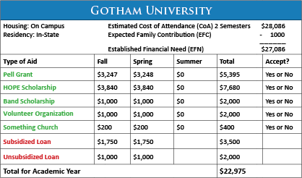
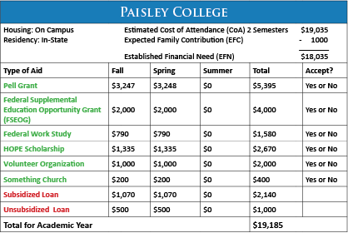
Compare Award Offers
Notes:
Here are two examples of award offers received by a student.

Slide 60
The Best Order to Accept Aid
1. Scholarships and Grants
Understand all the conditions
Make sure it is truly free
2. Work Study
Doesn’t have to be paid back
Money is paid through a paycheck based on hours worked
Consider class schedule and study time
3. Federal Student Loans
Must be paid back with interest
Consider a subsidized loan first – interest doesn’t accrue until repayment
4. State Government or College Loans
Must be paid back with interest
Understand all the conditions
5. Private Loans
Must be paid back with interest
Usually higher interest and less favorable terms
Understand all the conditions

Slide 61
Additional Resources

Slide 62
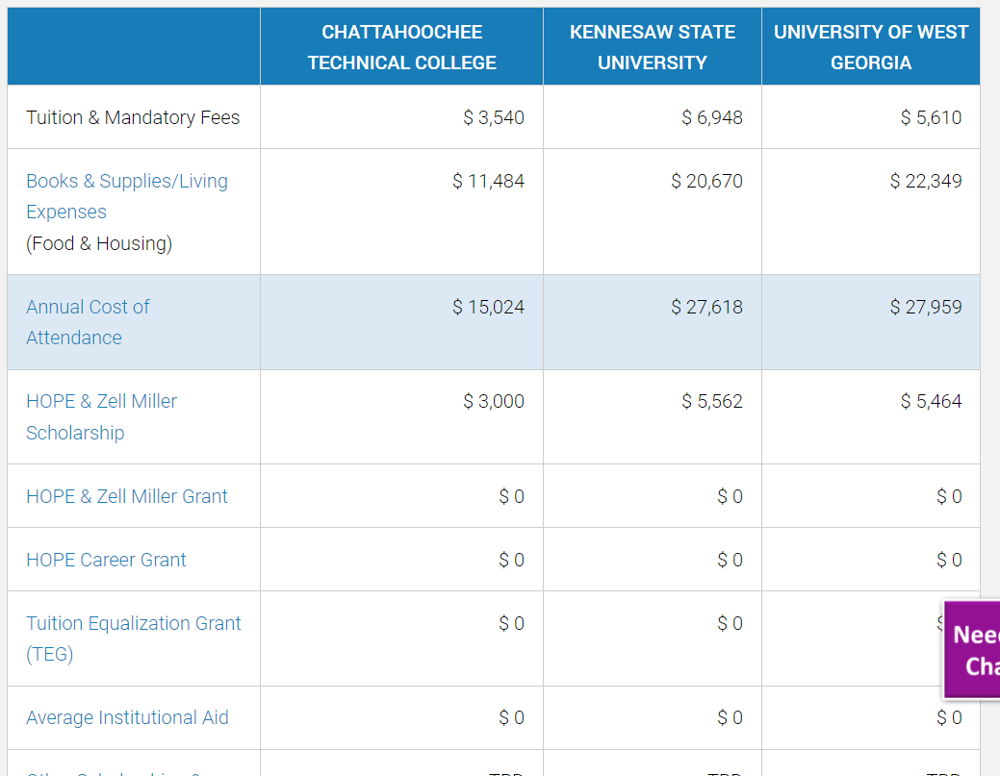
Additional Resources
GAfutures.org
GSFC.org
StudentAid.gov
Prepare for College
Complete FAFSA
Types of Aid
Who Gets Aid
Apply for Aid
Repay Your Loans
Notes:
Here are some additional resources to help you in the financial aid process.
GAfutures has sections dedicated to state and federal financial aid.
StudentAid.gov and it’s affiliated sites have a wealth of information about federal financial aid.

Slide 63
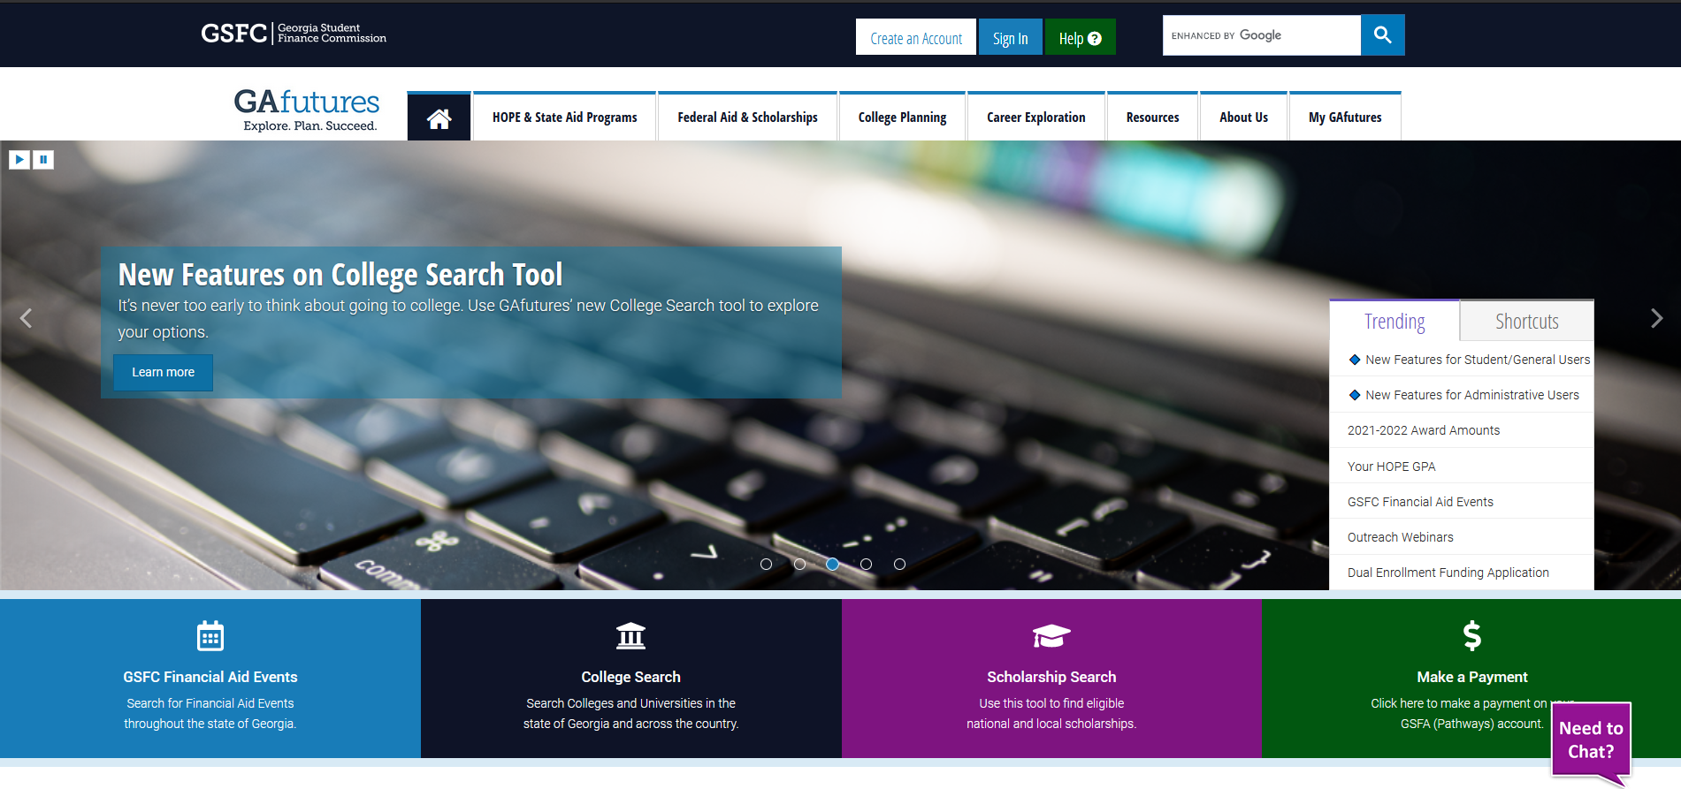
GAfutures.org
Notes:
This is Georgia’s primary resource to help students plan, apply, and find affordable ways to pay for their post-secondary education.

Slide 64
Your Next Steps
Create account at GAfutures.org
Check your HOPE GPA to see if you are on track to be eligible for the HOPE or Zell Miller Scholarship
Seniors: Complete the FAFSA beginning October 1

Slide 65
Contact Me!
404-706-1550
aroberts@gsfc.org
aroberts.gsfc
Notes:
You can also call our 800 number or email our Client Services with any questions you may have.

Slide 66
Be Social
Notes:
You can follow us on our GAfutures Facebook, Twitter and You Tube for all the latest and greatest information about financial aid – tips, resources, reminders, and more.

