Slide 1

Welcome Class of 2027

Slide 2
11th Grade Administrator
Dr. Jones
Christopher.jones@cobbk12.org

Slide 3
11th Grade Resources
Ms. Duncan and Ms. Storey – SGA (Student Government Association) Sponsors
Karen.Duncan@cobbk12.org
– Junior Class Sponsors
Ms. Ebbert and Mrs Turner
Ashley.Storey@cobbk12.org

Slide 4
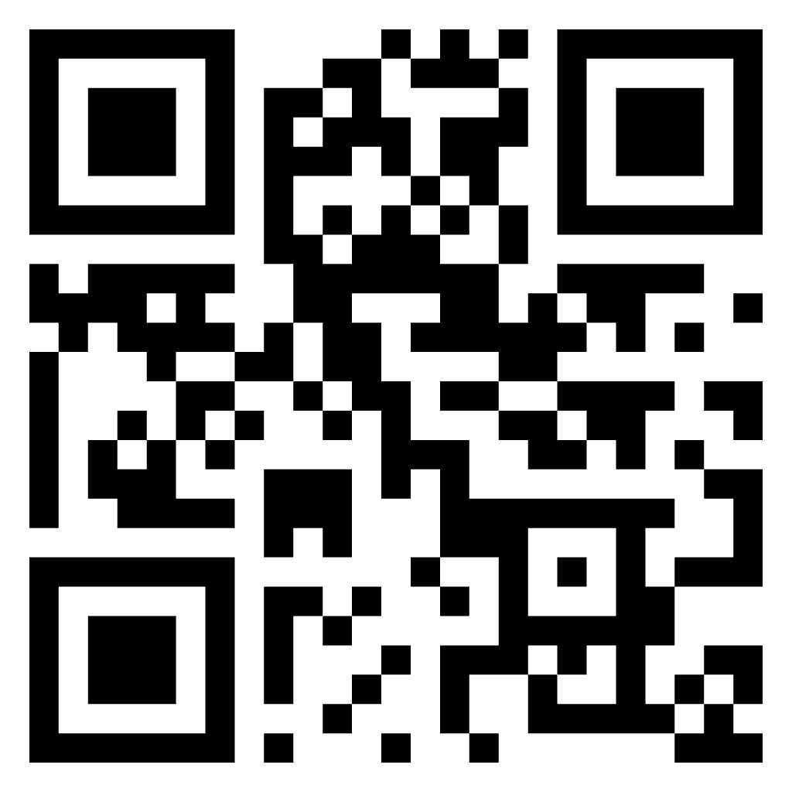
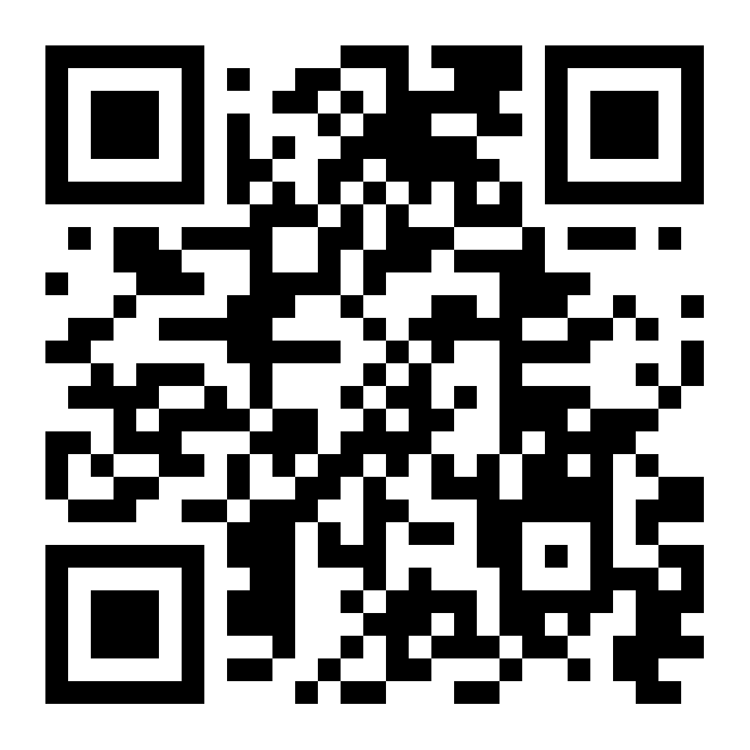
HOCO IS ON…
SHOW YOUR SPIRIT!
Welcome Back Class of 2027
october 3rd
VOTE FOR YOUR CLASS THEME!

Slide 5

Class of 2027 Candidate Speeches

Slide 6
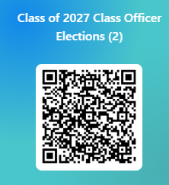
Class of 2027 Class Officer Voting links

Slide 7


Slide 8
CCSD Email Address first.last@students.cobbk12.org
Primary method of communication from the school
Check DAILY to ensure up-to-date information

Slide 9
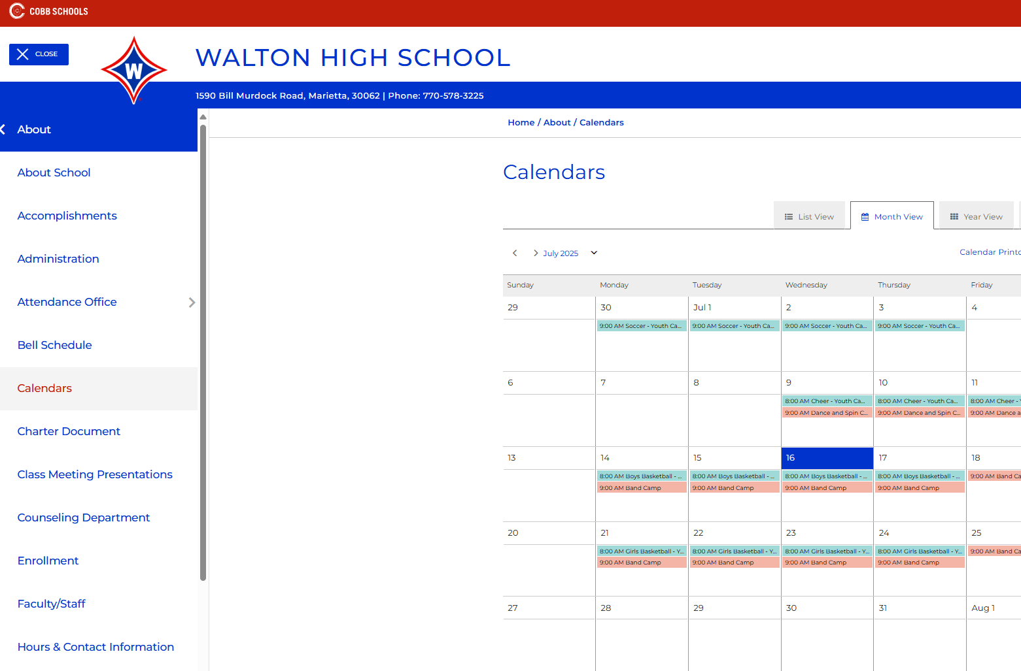
Walton HS School calendar https://www.cobbk12.org/walton/

Slide 10

Behavior Expectations
Get to school and class on time (7 min between classes)
You may not leave the school campus without permission
Bullying/harassment will not be tolerated
Vaping – 5 days OSS
Fighting – 10 days OSS
No gathering in an area for any reason other than its intended purpose (ex. The bathroom)
NO food deliveries from outside companies (UberEATS, Door Dash, etc.)

Slide 11

Cyber Bullying
24 hours a day/7 days a week
THINK before you post on social media
Administrators can and will enforce CCSD code of conduct for students who violate policy
GHSA has additional consequences for athletes —including loss of game time.
Notes:
Troy

Slide 12
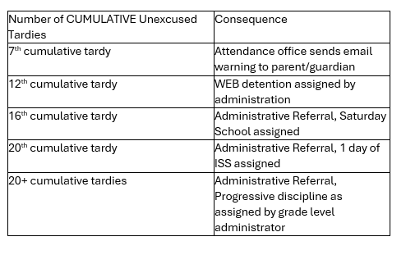
Tardy Policy
**WEB DETENTION – assigned by your grade level admin to be served during WEB either A or C block in the lunchroom. Reminders sent to students in HR the morning of.**

Slide 13
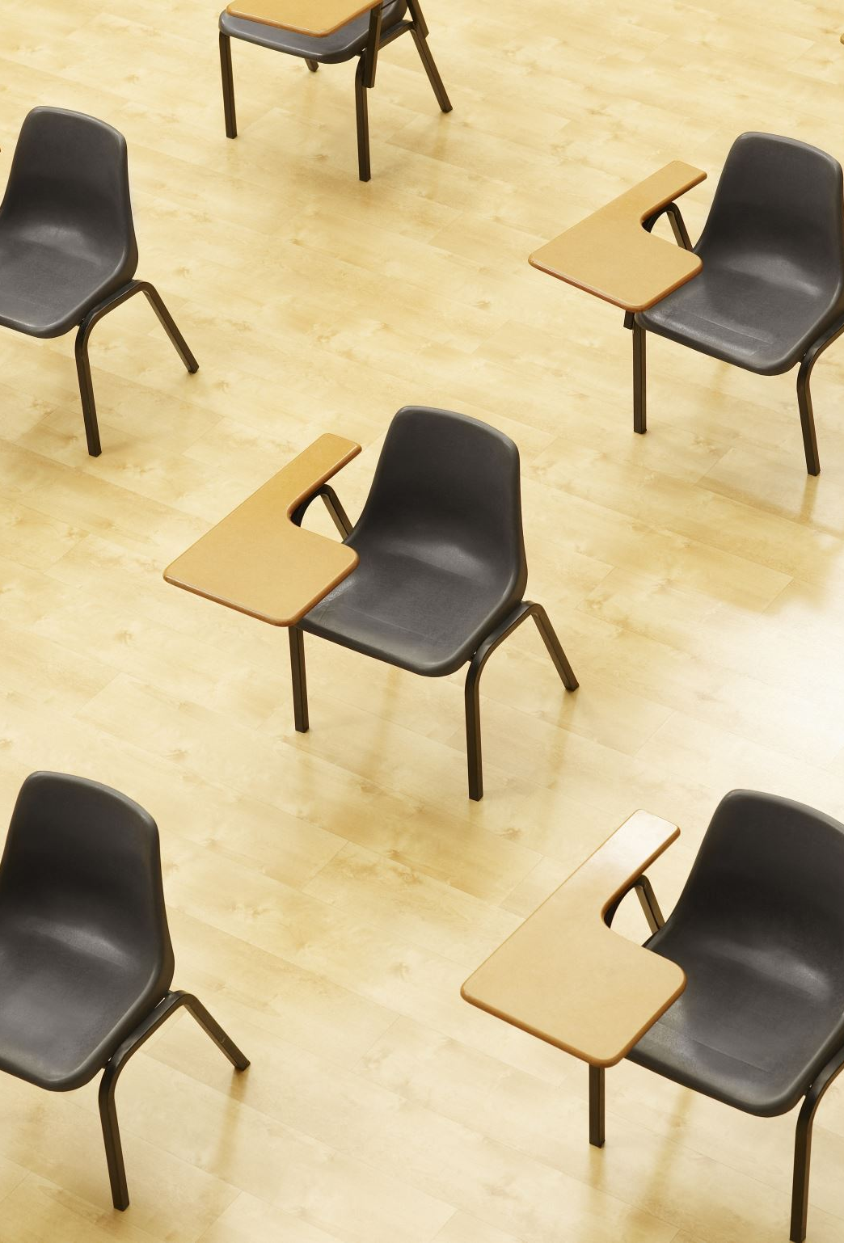
Honor Code
The faculty and students at Walton High School honor academic and personal integrity. We believe that every student has the right to learn in an environment free from academic dishonesty. Everyone has the duty to display honesty, integrity, respect, and responsibility, as these characteristics are essential in achieving and sustaining academic excellence. Academic integrity is expected on classroom assignments as well as on summer or supplemental assignments.
Student agenda – consequences for violations of the Honor Code on pages 4 - 6

Slide 14
Dress Code
Walton Wear vs Weekend Wear
No hats & hoodies
Length of shorts/skirts
Length of shirts – No midriffs
Undergarments should be worn under other clothing and should not be visible!

Slide 15
Honor Code
Academic Dishonesty
We believe that every student has the right to learn in an environment free from academic dishonesty. Each individual has the duty to display honesty, integrity, respect, and responsibility. Academic integrity is expected on classroom assignments as well as on summer or supplemental assignments.
Student Agenda
  Description and Consequences
  Failure to understand the honor code does not excuse infractions.
Notes:
Pam

Slide 16
WEB (Wednesday Enrichment Block)
Zero Period
7:10 - 8:12 (62 min)
1st Period
8:20 - 8:50 (30 min.)
Homeroom
8:56 - 9:05 (9 min.)
2nd Period
9:11 - 9:40 (29 min.)
3rd Period
9:46 - 10:15 (29 min.)
4th Period
10:21 - 10:50 (29 min.)
5th Period
10:56 - 11:25 (29 min.)
6th Period
11:31 - 12:00 (29 min.)
7th Period
12:06 - 12:35 (29 min.
Q Block
12:35 -12:55 (20 min.)
A Block
1:00 - 1:25 (25 min.)
B Block
1:30 - 1:55 (25 min.)
C Block
2:00 - 2:25 (25 min.)
D Block
2:30 - 3:00 (25 min.)
3:00 - Cafeteria to wait for bus dismissal OR exit the front of the school for your car ride

Slide 17

Importance of 11th Grade
Mrs. Watford – School Counselor

Slide 18
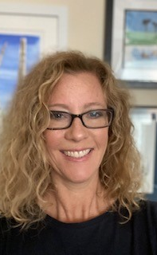
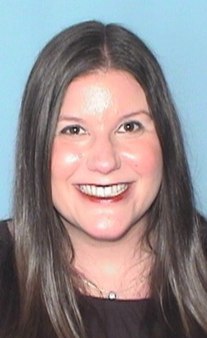
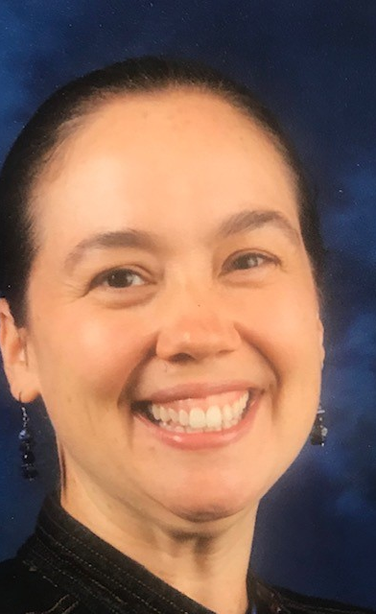
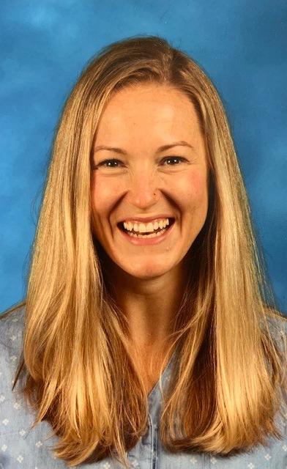

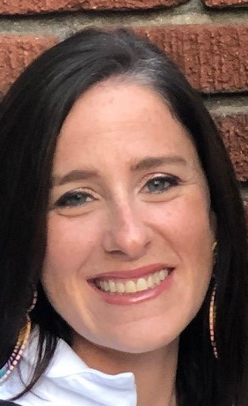

Mrs. Clary
A - Ch
Dr. Alpert
Ci - G
Mrs. Dunham
H - K
Mrs. Watford
L - N
Mrs. Jackson
O - SL
Mrs. Fay
Sm - Z
Who are your school counselors?

Slide 19
11th Grade Year
PSAT Day –
    Wednesday, October 8th (9th and 10th graders)
    Wednesday, October 22nd (11th graders)
Dual Enrollment for next school year
HOPE GPA & rigor courses
Ask for help when needed
Get involved!
Notes:
`

Slide 20
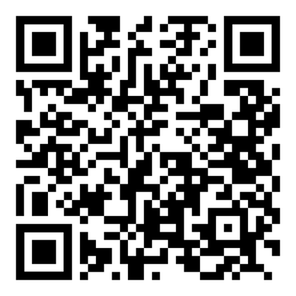

How to stay in the know with the Counseling Department!
https://linktr.ee/waltoncounselingsocialmedia

Slide 21

Athletics and Sportsmanship
Expected Behavior
  Cheer for our teams/students
  Do not yell disparaging remarks at opponents, fans, or officials.
  Ejection from an event can result in suspension from future events

Slide 22
Athletics and Extracurricular Information
Attend events - get connected
How to purchase tickets- GoFan.com
All sports pass (www.mypaymentsplus.com)
Clubs/Organizations
  www.cobbk12.org/Walton > Extracurricular > Extracurricular > Clubs and Organizations

Slide 23

Have a great school year!

